Slide 1
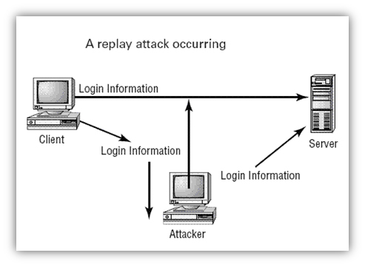
Replay Attack
http://rzld.blogspot.co.id/2012/03/replay-attack.html

Slide 2
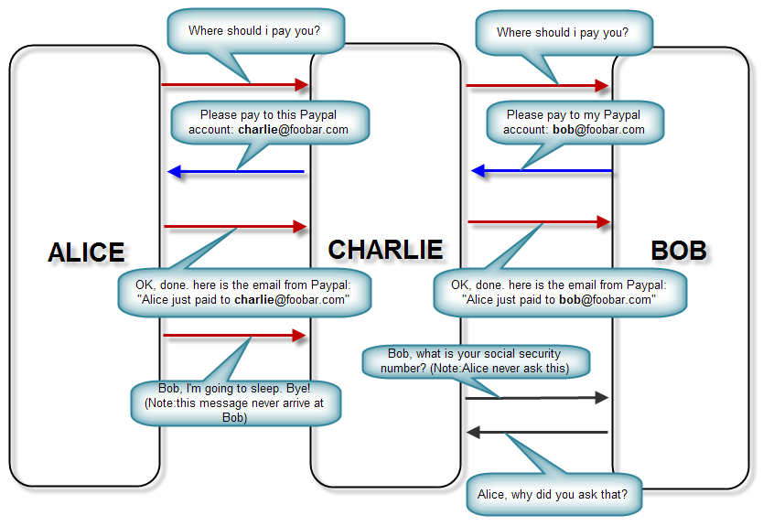
Man in The Middle
http://www.ilmuhacking.com/basic-concept/mengenal-serangan-man-in-the-middle-mitm/

Slide 3
Brute Force Attack
Brute force (also known as brute force cracking) is a trial and error method used by application programs to decode encrypted data such as passwords or Data Encryption Standard (DES) keys, through exhaustive effort (using brute force) rather than employing intellectual strategies
Ref http://searchsecurity.techtarget.com/definition/brute-force-cracking
n cryptography, a brute-force attack consists of an attacker trying many passwords or passphrases with the hope of eventually guessing correctly. The attacker systematically checks all possible passwords and passphrases until the correct one is found. Alternatively, the attacker can attempt to guess the key which is typically created from the password using a key derivation function. This is known as an exhaustive key search.
https://en.wikipedia.org/wiki/Brute-force_attack
http://security.stackexchange.com/questions/70571/one-time-passwords-resist-against-bruteforce-attacks-immune-alternative

Slide 4
ONE TIME PASSWORD
One Time password merupakan mekanisme untuk login ke server dengan mengirimkan data otentikasi yang hanya valid saat itu juga.
Data yand dikirim untuk validasi berikutnya tidak sama sehingga menghindari terjadinya pencurian account, yang dilakukan dengan cara memastikan bahwa password sudah dikirim tidak dikirim kembali.
Salah satu dari jenis Penerapan One Time Password adalah Lamport One Time Password.

Slide 5
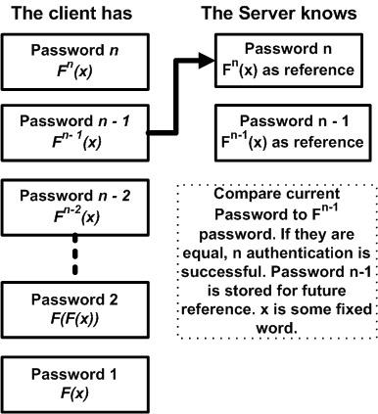
Lamport One Time Password

Slide 6
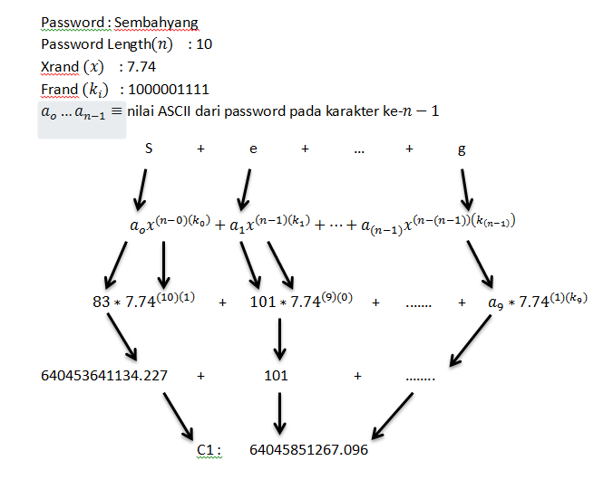
Perhitungan C1(Contoh fungsi dlm OTP)

Slide 7



OTP Implementation
(IMEI)
Request App_ID
Install app
Check App_ID from SQLite. If not exist then Request App_ID
You have Registered Notification
if IMEI not exist, create new App_ID, store App_ID and IMEI
(App_ID)
Return App_ID
Input to Registration Form and press register
Store App_ID then View Registration page
(name, password, email, App_ID)
(name, password , email)
Request OTP Registration
Failed Notification
Check if Email exist by App_ID, if not exist, server store name, password , email and gives notification
Check Format, if valid, request OTP registration, else Show Failed notification
Success Notification
Store App_ID and password to SQLite , login to Main Page

Slide 8
OTP Start App(contoh)
(App_ID)
Request Check Password
Start app
Check Password from SQLite, if password not exist, then Request Check Password
Check password Existence by App_ID
(Registered)
(Unregistered)
Input to Registration Form and press register
If unregistered, View Registration layout, if registered View Notification
(name, password, email, App_ID)
(name, password, email)
Request OTP Registration
Error Notification
Check if Email exist by App_ID, if not exist, server store name, password , email and gives notification
Check Format, if valid, request OTP registration, else Show Failed notification
Success Notification
Store App_ID and password to SQLite , login to Main Page

